Slide 1
Name : Swapnil Ghosh Department : IT
Roll : 001911001067
TASK 3

Slide 2
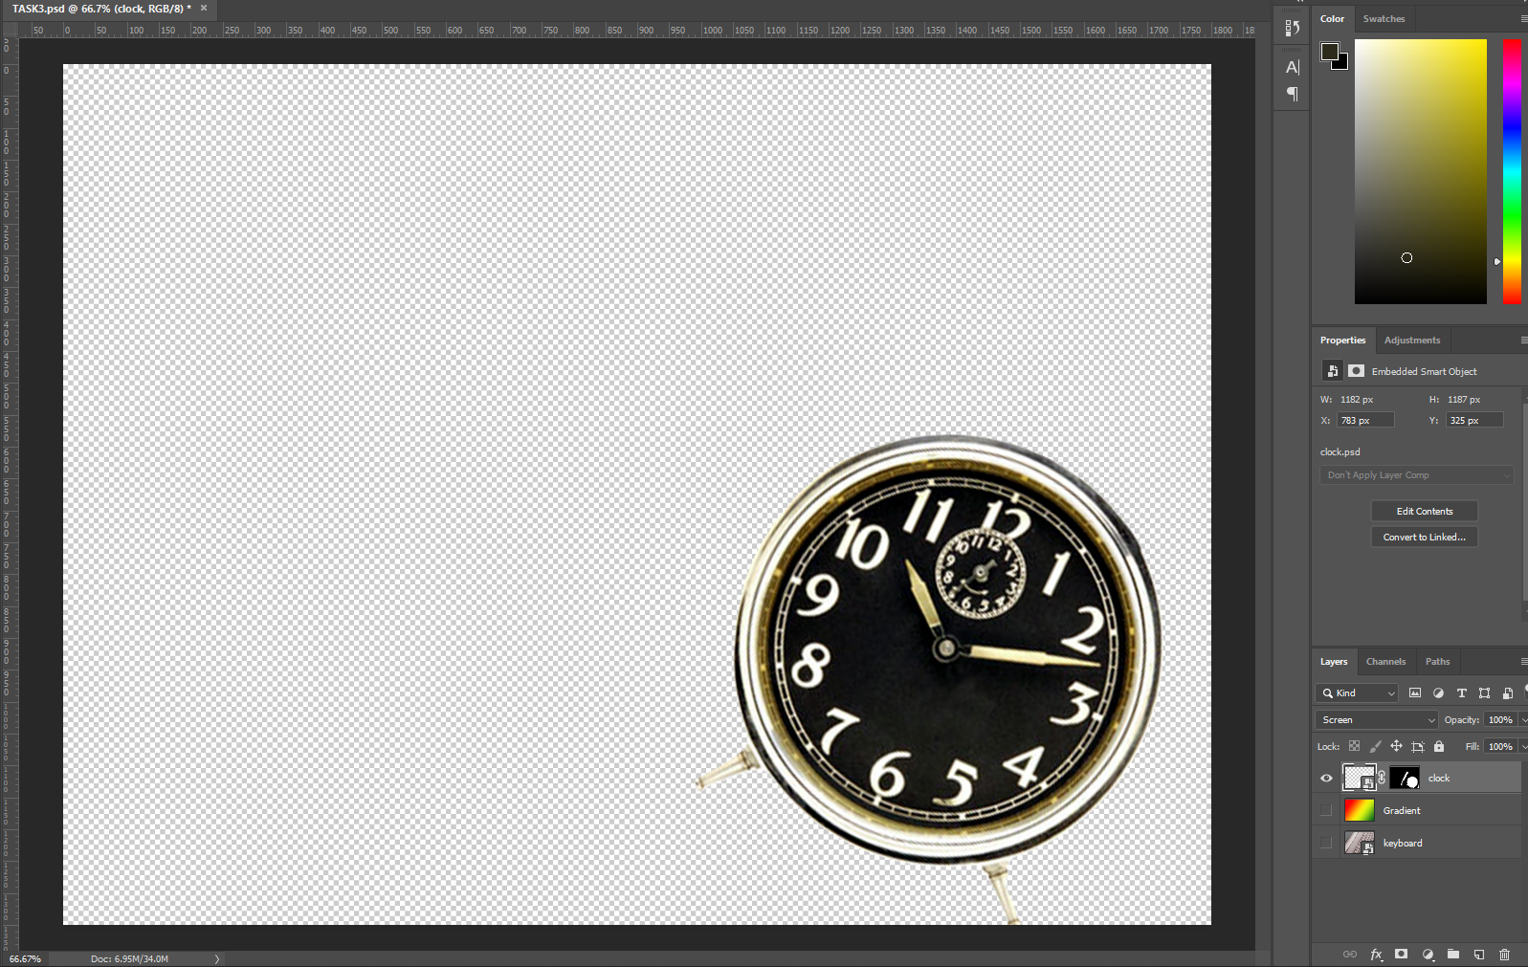
Step-1) Opened the KEYBOARD.PSD, CLOCK.PSD in photoshop and put the CLOCK.PSD over the KEYBOARD.PSD
Step -2) Used the Magic Wand tool to select the white background portion of the clock and pressed DEL key to make its background transparent.
Step -3) Layers palette change the blending mode of the Clock layer to Screen and make its Change opacity opacity 80%.
Step -4) Use the Transform function to rotate the clock and scale down its size.

Slide 3
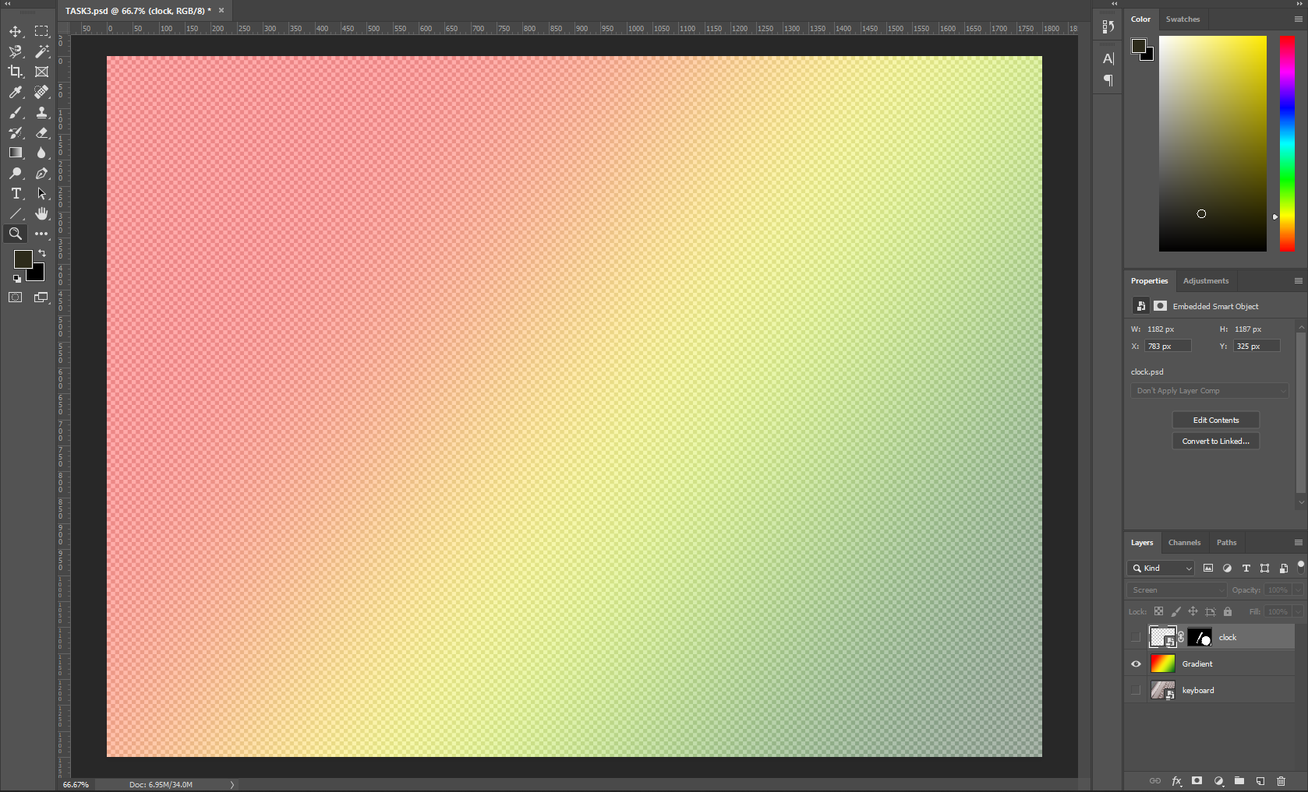
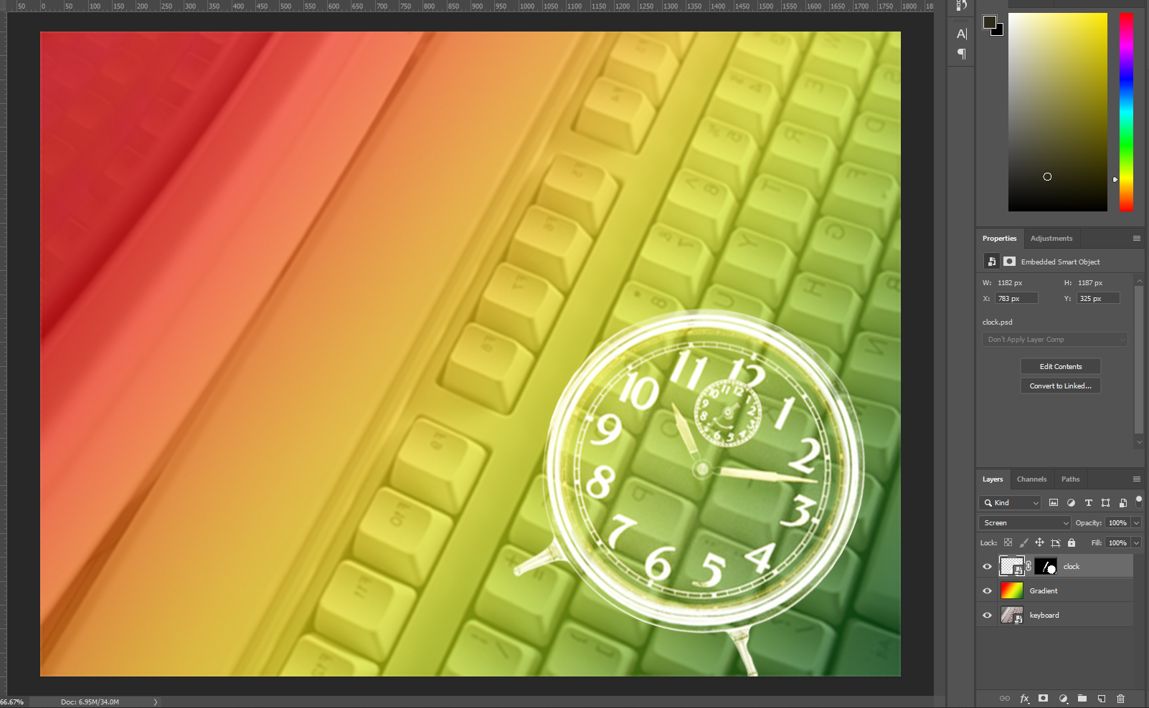
Step - 5) Created a new layer just above the Background layer.
Step - 6) Renamed the new Layer as Gradient.
Step – 7) Selecting the Gradient layer open the gradient editor by clicking on the Gradient tool.
Step-8) Using the Gradient Editor, we created a new Gradient.
Step - 9) Selected the Gradient layer in the Layers palette and using the gradient tool we drag from top left corner of the image to the bottom right corner.
Step – 10) Decreased opacity of gradient layer to 60%.
The End

